Slide 1
curator
Evidence code
creates
Reads + interprets
Literature curation is one example for evidence code creation. Automated assertions are produced by e.g. PAINT.
Researchers can also create assertions
Journal article
writes
Below is what needs to be in OBI
author
investigation
conducts
Has part
data
Drawing conclusion
conclusion

Slide 2
Drawing conclusion (inference)
Deductive inference
Inductive inference
Non-deductive inference
Whatever inference (instance level explanation)
data
conclusion

Slide 3
A conclusion is the output of an ‘interpreting data process’, in which data items are used to support the conclusion. There are different types of interpreting data
Processes. This part
Been added to OBI.
Conclusion
Data item
Supported by
Written assertion / statement
Hypothesis
Prediction
implies_that
Triple
(We may or may not be able to directly point to the implications. The problem is that we may run into confusion what is a statement in the ontology vs.

Slide 4
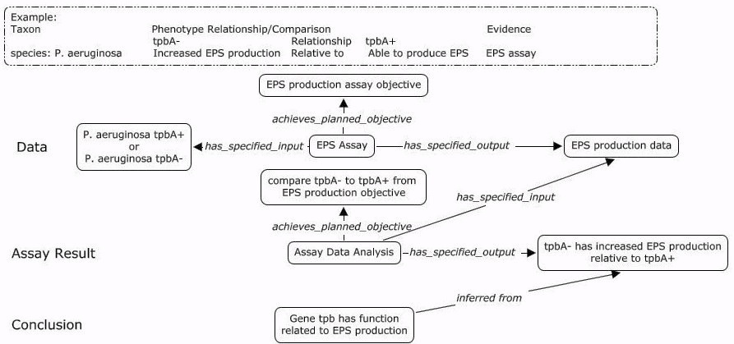
Use the following example (Marcus’ presentation slide 14)
- model using OBI terms
(slide add by Jie)

Slide 5
Terms added in OBI
phenotypic assessment
interpreting data
has_specified_input some ('measurement datum'
and ('is about' some (organism or ('is part of' some organism))))
has_specified_output some ('conclusion textual entity'
and ('is about' some ((disposition or quality)
and ('inheres in' some (organism or ('is part of' some organism))))))
assigning gene property based on phenotypic assessment
interpreting data
has_specified_input some (is_specified_output_of some 'phenotypic assessment')
(slide add by Jie)

Slide 6
Model Phenotype and Assay
Evidences that
support the conclusion
tpbA- has increased EPS
Production relative to tpbA+
Gene tpb has function
Related to EPS production
EPS production data
Conclusion
Textual entity
Conclusion
Textual entity
Data item
has_specified_output
has_specified_output
has_specified_output
has_specified_input
has_specified_input
Phenotypic
assessment
assigning gene property based on
phenotypic assessment
Assay
EPS Assay
(slide add by Jie)

